Slide 1

By: Steven Cao

Slide 2
What is the Weights & Biases module and its functions?
Weights & Biases Module
A Python package that allows us to monitor our training in real-time.
Easily Integrated with PyTorch, Tensorflow, or Keras.
W&B help teams track their models, visualize model performance and easily automate training and improving models.
Functions
Store hyper-parameters used in a training run
Search, compare, and visualize training runs
Analyze system usage metrics alongside runs
Collaborate with team members
Replicate historic results
Run parameter sweeps
Keep records of experiments available forever

Slide 3
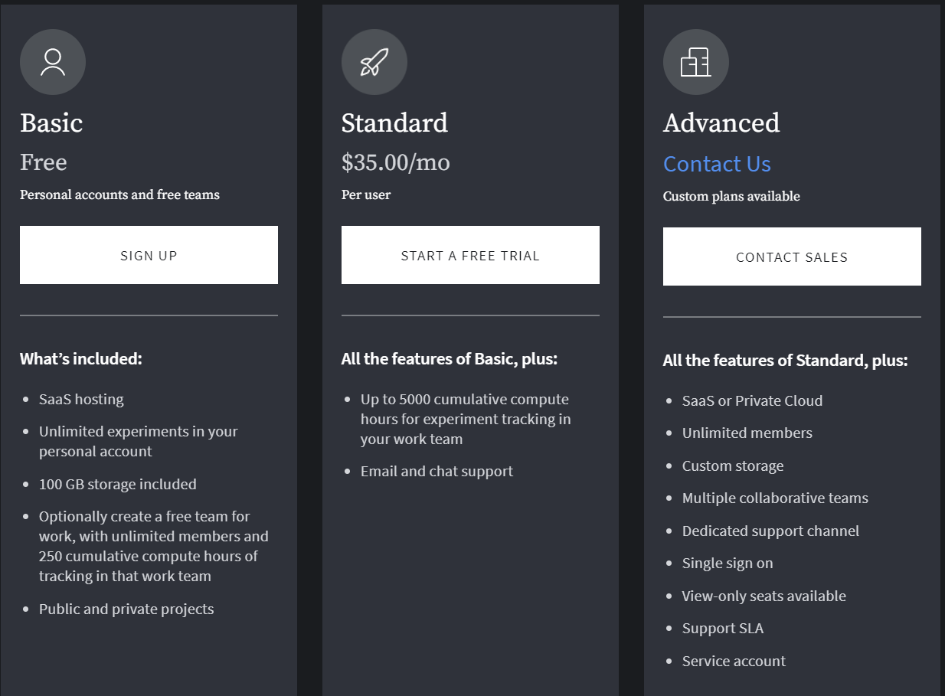
What are the prices for this Module?

Slide 4
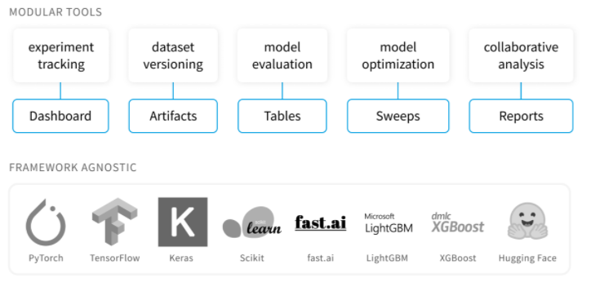
Module’s Modular Tools

Slide 5
Key wandb commands
wandb.login()
Logins into your W&B account for syncing your data to the dashboard
wandb.init()
Creates a new run in W&B and launches a background process to sync data.
Ex. wandb.init(project='ecg1')
wandb.config()
Saves your training configuration: hyperparameters, input settings like dataset name or batch_size, and any other independent variables for your experiments. This is useful for analyzing your experiments and reproducing your work in the future.
This is where you give info about your model parameters, so that you can compare
Ex. wandb.config.batch_size = 32
wandb.watch()
This command will automatically collect the model’s gradients and the model’s topology.
Ex. wandb.watch(model, criterion)
wandb.log()
The .log() command will capture all the arguments and send them to the W&B instance. This will allow us to access and track them from the UI.
Ex. wandb.log({“accuracy”: accuracy, “loss”: loss})

Slide 6
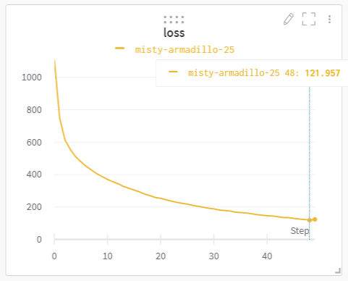
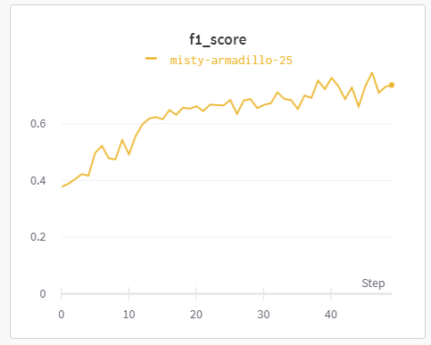
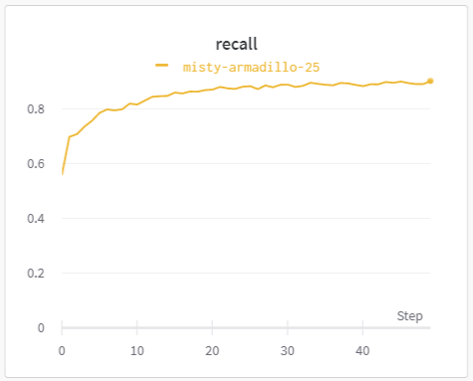
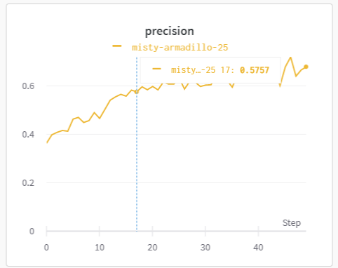
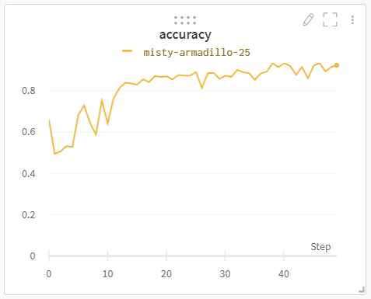
What you can do with Weights & Biases?
Visualize model performance that you logged (ECG data)

Slide 7
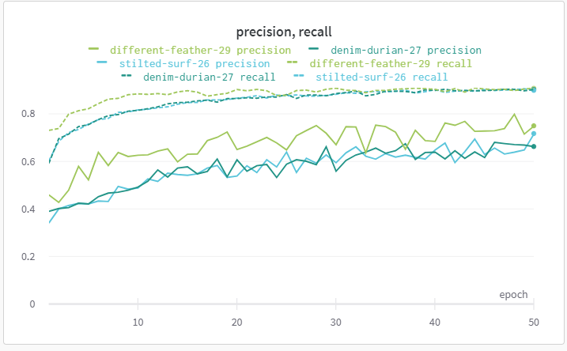
Compare multiple metrics of multiple runs (ECG data)
Conclusion: We can compare the recall and precision for each run towards each other

Slide 8
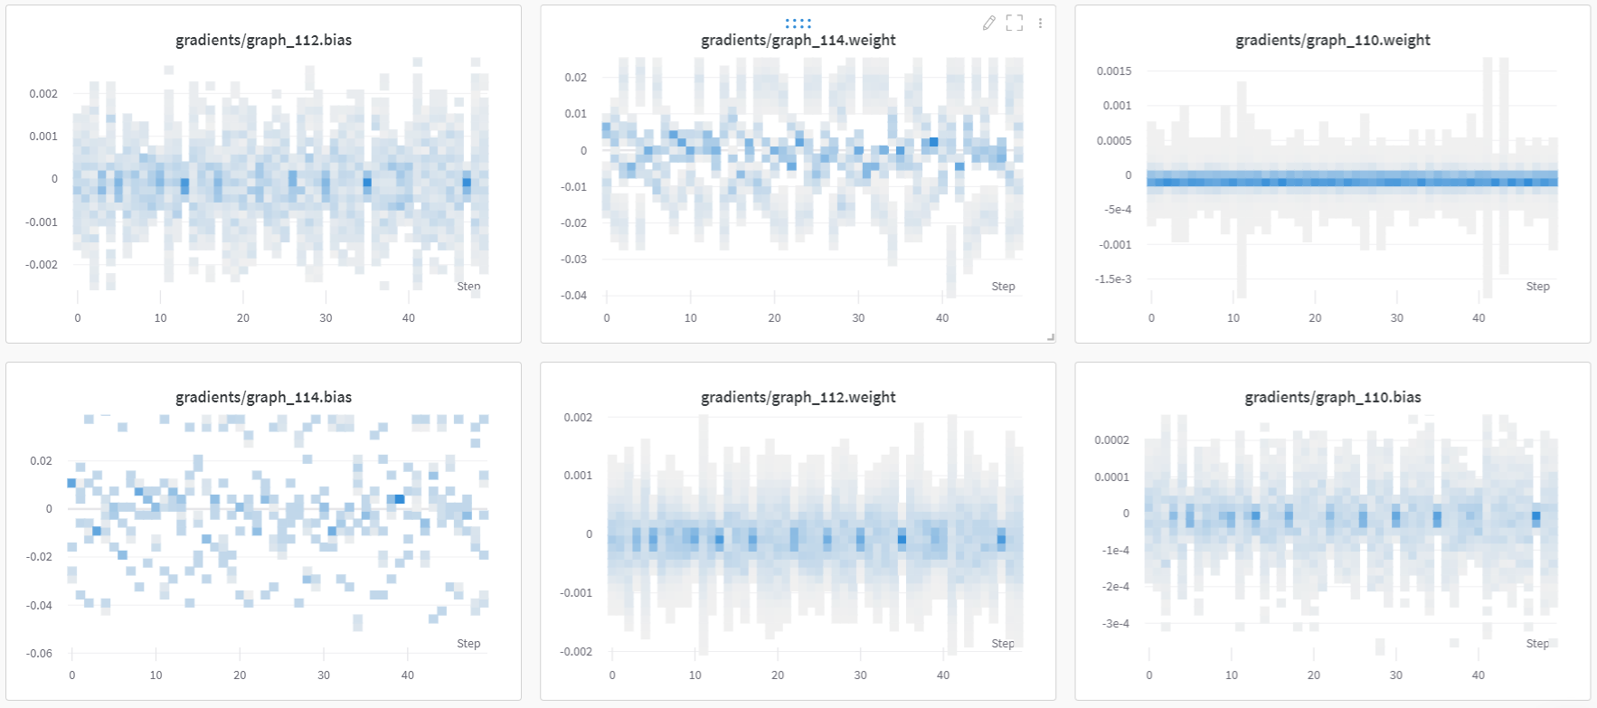
See the gradients for each weight and bias over time for a run(ECG data)
Conclusion: This is useful to see if the gradients are exploding or not, without having to plot them manually

Slide 9
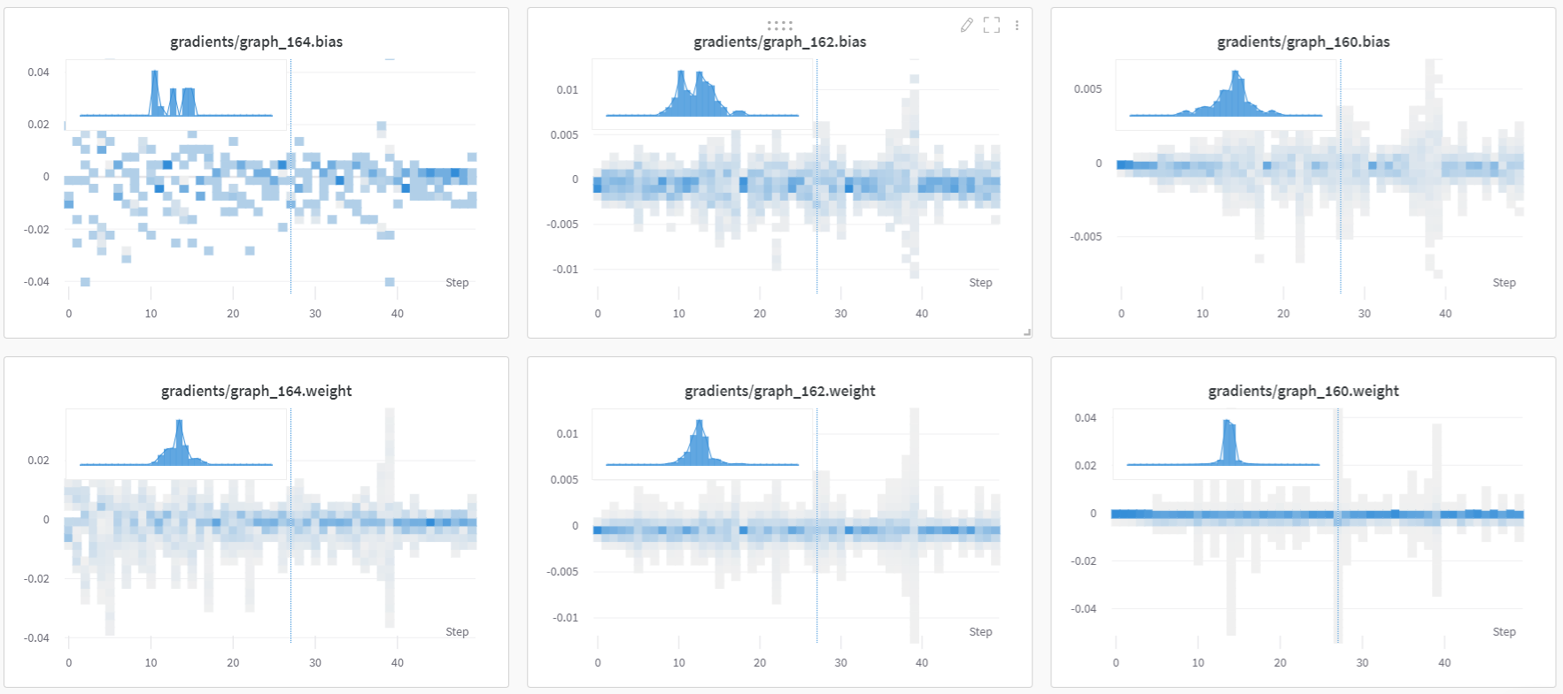

Slide 10
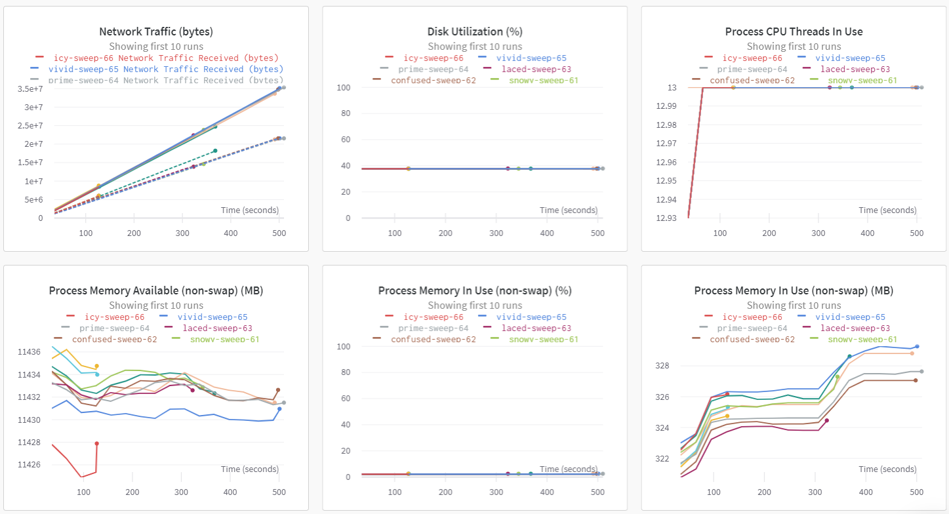
See System metrics (ECG data)

Slide 11
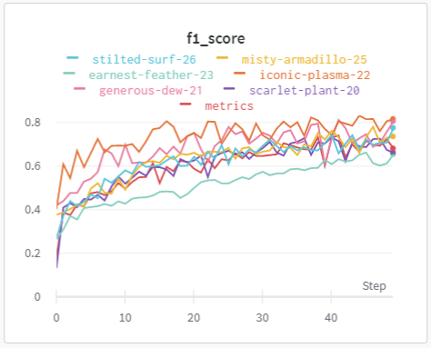
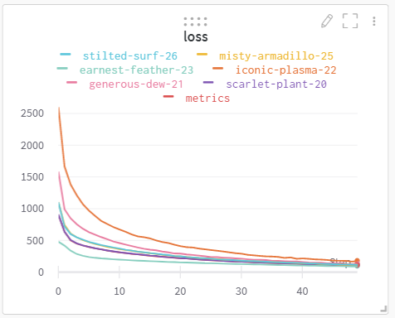
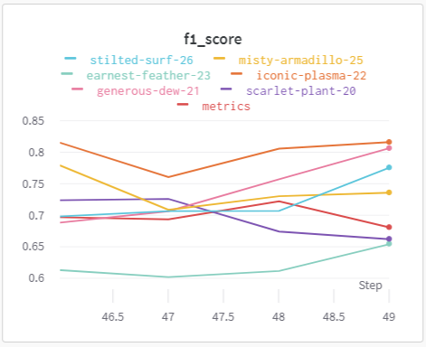
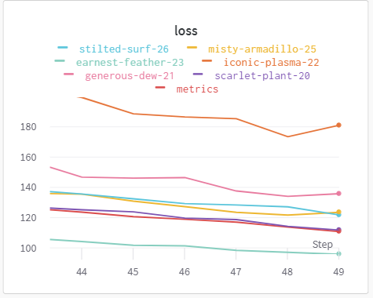
Compare your performance with multiple runs(ECG data)
Highlight an area to zoom in

Slide 12
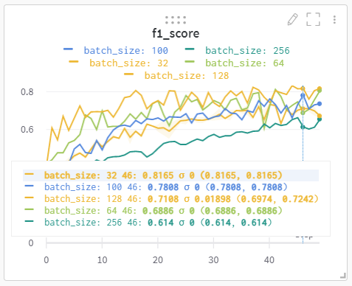
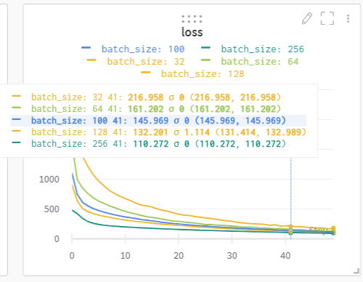
Use grouping to check runs with different batch_sizes(ECG data)
Batch_size
Allows you to compare the metrics of different batch sizes
Conclusion: W&Bs has lots of options to visualize model performance

Slide 13
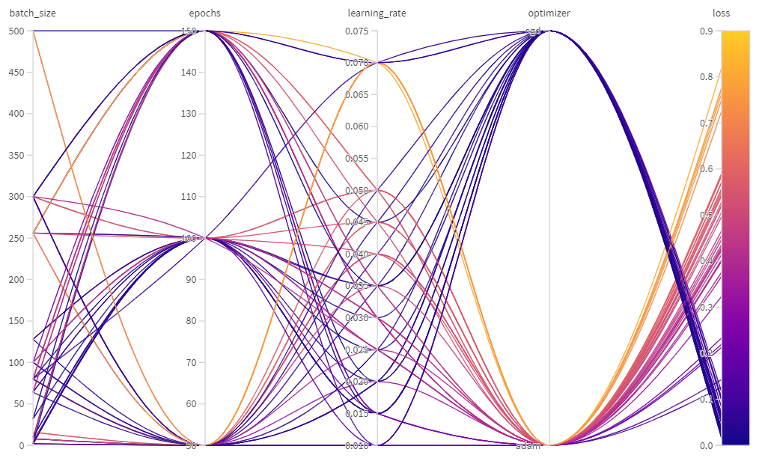
What else can the Weights and Biases Module do?
Hyperparameter Sweeps(ECG data)
Used W&B sweeps to automate hyper parameter optimizations. Here I optimized the learning rate and the batch size.

Slide 14
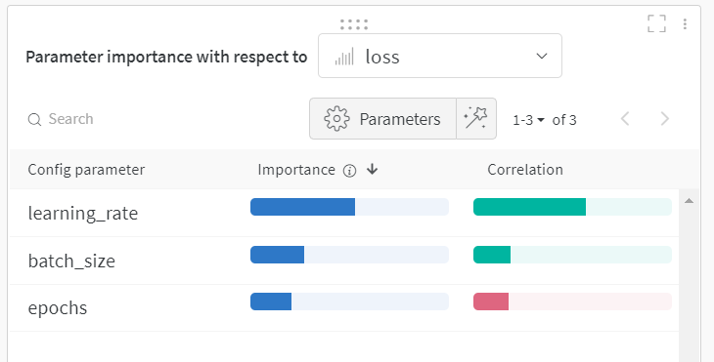
Hyperparameter Importance Plot (Goes along with the hyperparameter sweeping)
Conclusion: This plot tells us that the learning rate is the most important hyperparameter for minimizing the loss and that if we increase the learning rate, then, the loss will also increase as they have a positive correlation.

Slide 15
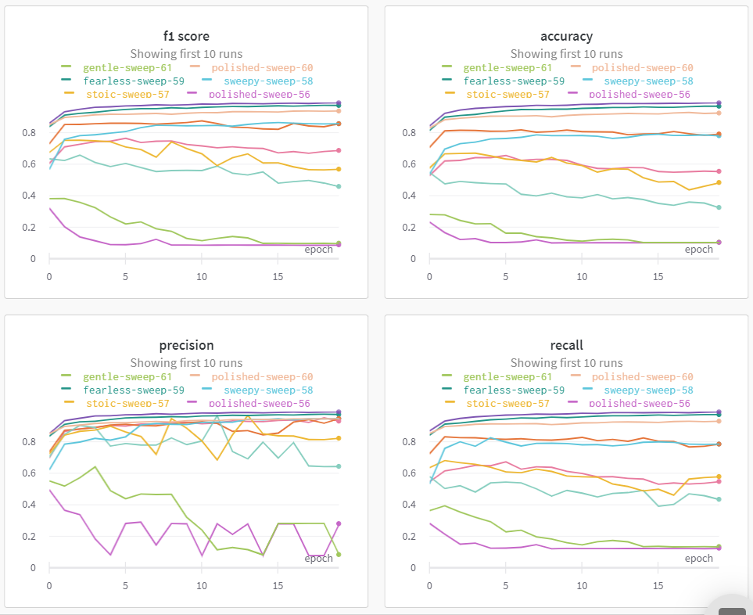
See the metrics for each hyperparameter sweep
Conclusion: The different hyperparameters causes a wide range of results as seen from the graphs.

Slide 16
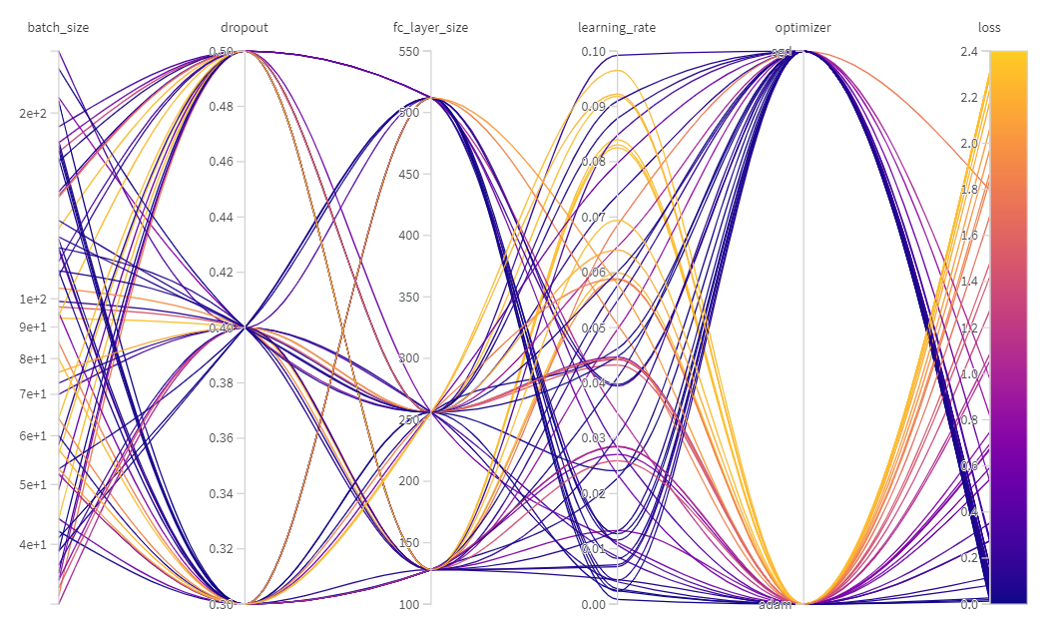
Hyperparameter Sweeping on the MNIST dataset
Optimizing now the batch_size, dropout, learning_rate, optimizer, and the fc_layer_size

Slide 17
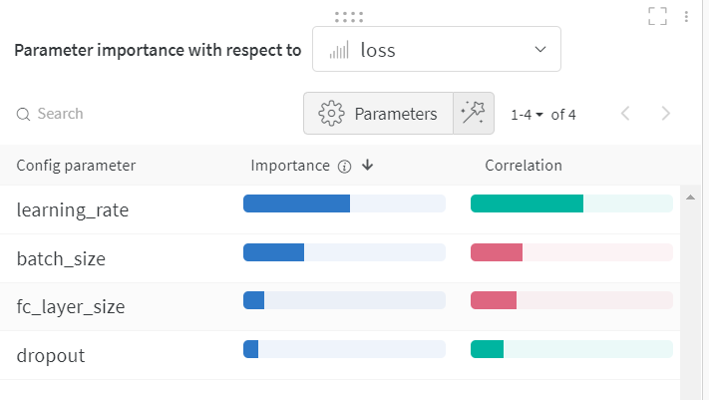
Hyperparameter Importance Plot
Conclusion: We can see positive levels of correlation between the learning_rate and the loss.

Slide 18
Resources
https://docs.wandb.ai/quickstart

Slide 19
Google Colab where I incorporated the Weights & Biases Module
MIT-BIH: https://colab.research.google.com/drive/1vqwoeJB3TbnN3OaqiB-zy1R7OwPItnnD?usp=sharing
MNIST: https://colab.research.google.com/drive/1OIIYfRXqW1zG1-02snfINEMRFJnix3Je?usp=sharing

